Slide 1
Kasia Idzi
Action Research Project Presentation | 17th January 2024
Notes:
Image by https://pixabay.com/users/geralt-9301 https://pixabay.com/photos/to-learn-training-books-a-book-4226965/

Slide 2
Research question
How as Course Librarians can we better support our Wimbledon students in evaluating and using variety of library resources to promote sustainability and help students to include their voices?

Slide 3
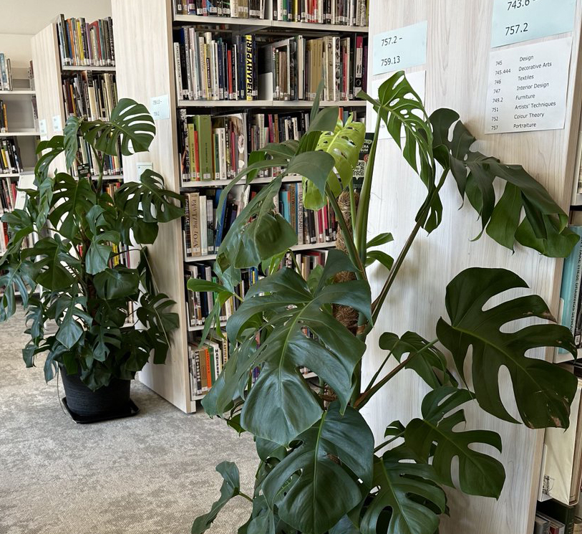
Context of the project

Slide 4
Rationale for selecting my topic

Slide 5
“One of the themes that came through from the interviews was that the students tend to equate library resources with books. It became apparent that library resources tended to be seen as the books and by the internet they meant the wider internet beyond library resources.”
(Bloom, 2023, p.22)
Notes:
Personal: interest in info literacy; studying on Pg Cert picked my interest in critical pedagogy and inclusivity
Professional – local circumstances (renovation has finished, new room, collections finally in one place); other colleague did MA in Academic Practice and in her work I could see how students perceive our library and resources and I recognised the need for teaching more about resources

Slide 6
“Students often use only superficial criteria like whether or not the web page includes advertisements or flashy graphics to evaluate Internet sources and do not delve into a deeper analysis of sources. (…) They also often could not explain exactly what criteria they were using.”
(Faix, 2014, p.627)
Notes:
Literature on the subject of Info literacy confirms the need to teach students on it and looking into evaluation of the resources specifically

Slide 7
“Information literacy and self-learning have a strategic and mutual relationship with each other. (…) Both are self empowering: both the concepts are aimed to help all categories of individuals, regardless of their social, economical, cultural and educational status, as well as their place, gender, race, religion or ethnic background in the society.”
(Shigwan, 2014, pp.341-342)
Notes:
I used this quote to show how IL is linked with social justice issues. The skills we get in the process of learning to research effectively can empower us in all areas of our lives. In the literature on the sustainable IL you can find that all IL skills lead to more environmentally sustainable life – more effective searches, less of them will save energy, but being able to evaluate better the info we get leads to changes in lifestyle, activism..

Slide 8
Research methods used

Slide 9
Learning about research methods for this project
Padlet on research methods

Slide 10
Questionnaire
Notes:
It was a short questionnaire to gather some initial thoughts from my team on the project and our teaching of IL and critical thinking.
Example of question:
Chance for the participants to give more info at the end; a question to follow up the one too

Slide 11
Main theme/category and subthemes |  | What the participants said
How we see ourselves: libraries and teaching IL
 | We could do more teaching on IL | "I don't think we do enough of it, and I want to offer more" "we don't spend enough time helping with critical thinking about resources" "we should offer more sessions about library resources" "I think that the sessions that we run are good, but we should run more"
 | We are good at it (or we do something right) | "our support is very good for some students but I have answered 'somehow good' as not all students have the same experience" "I think we are doing very well in presenting students with a variety of materials" "I think that the sessions that we run are good, but we should run more"
 | What does not work for us at the moment | "Library services are always there, but attracting interest is hard" "What doesn't work for me is the lecturing in big theatres where you can't connect with the students."
Notes:
Chart from the responses

Slide 12
Questionnaire findings that informed my focus group:
Our teaching on resources and IL is good, however, we are not doing enough of it. (4 out of 5 participants pointed this).
We see the need for working closer with the academics from other departments and going to the classrooms to make our teaching more closely related to what students are currently researching. It would be interesting to ask in the focus group how we can do it in our library space.
We need students perspective to be effective in our sessions. (3 participants mentioned it). Another interesting theme to explore in the focus group to help to answer my question.
The conversation about our IL teaching is very timely for our team We have new teaching space and all the collections finally in place ready to be explored. To address low students engagement we need to cooperate and find ways to bring them in.

Slide 13
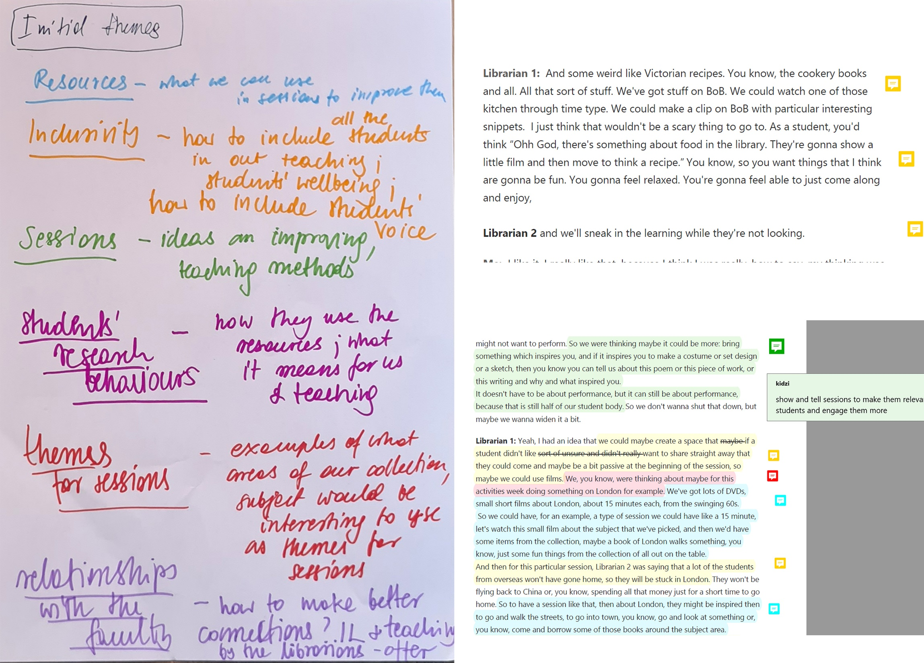

Slide 14
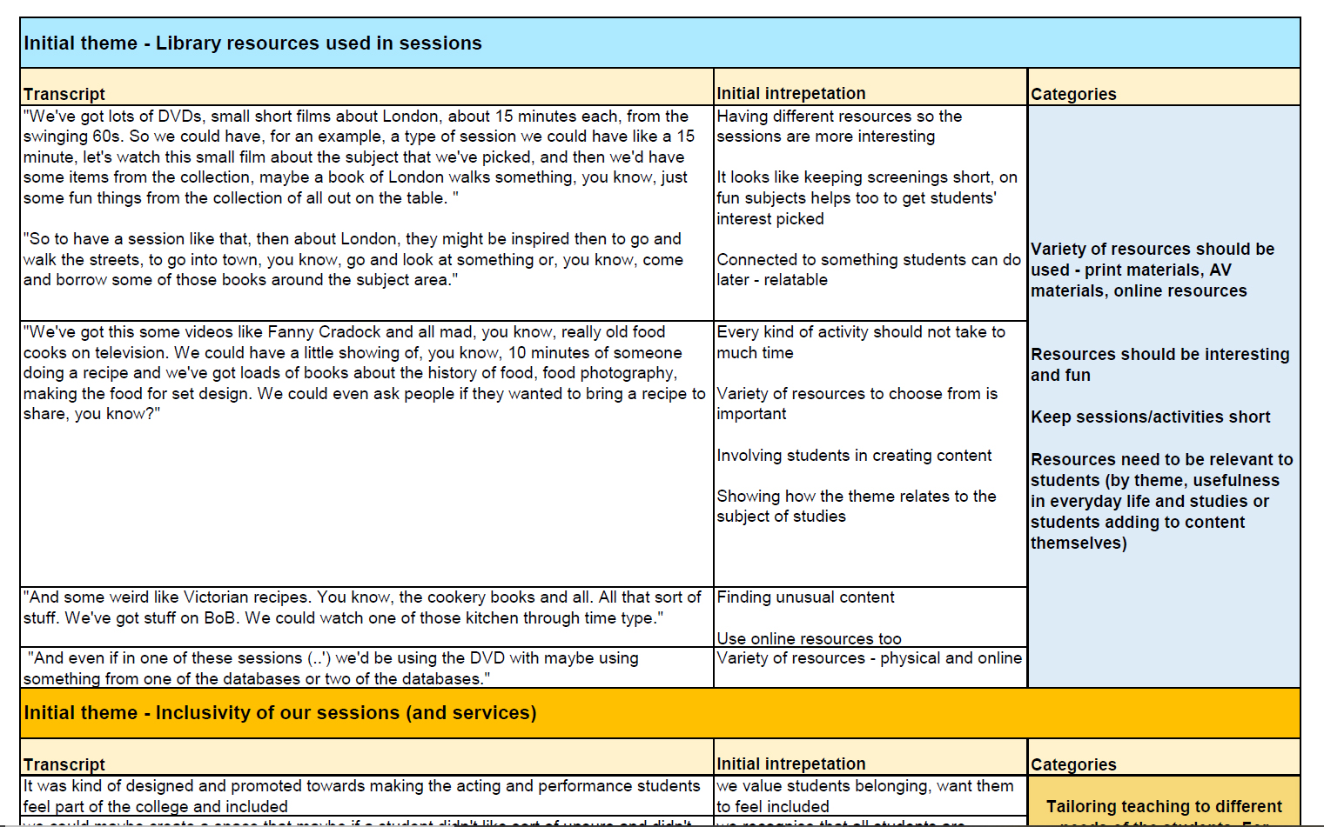

Slide 15
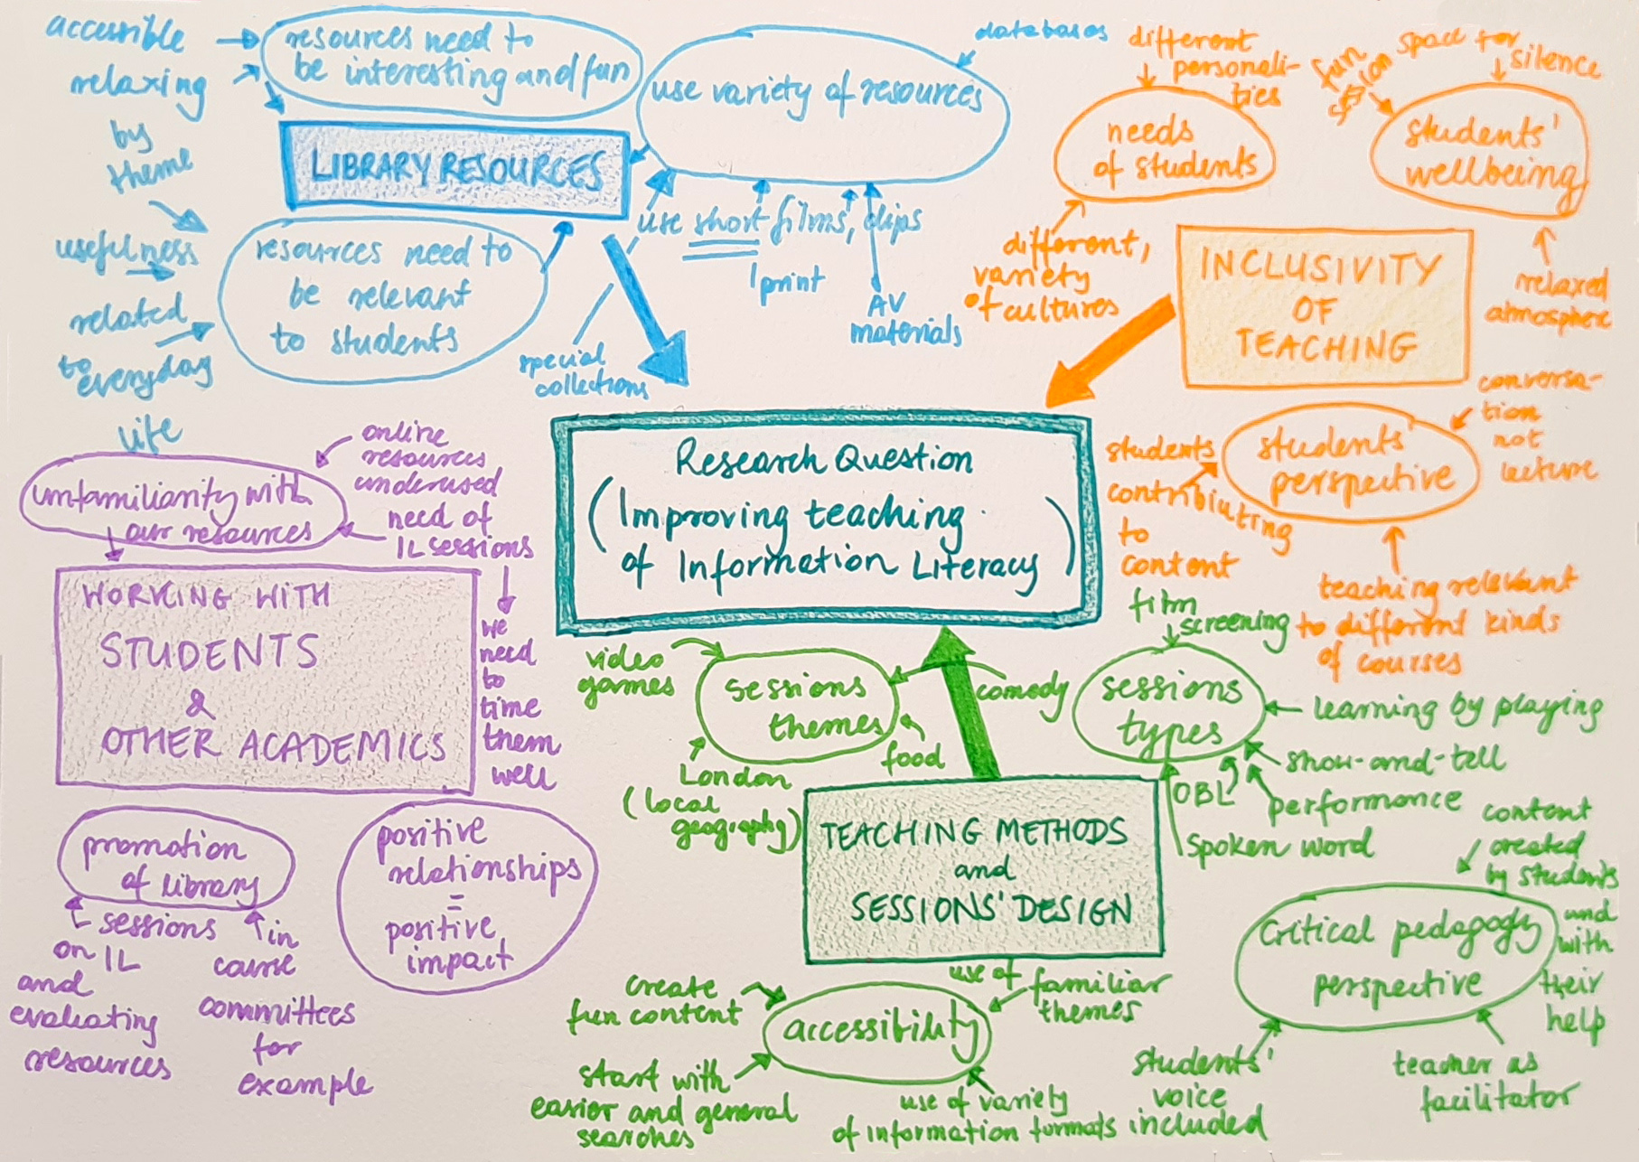
Notes:
Overarching themes

Slide 16
Summary of project findings

Slide 17
Project went through some changes
Things that worked:
Great opportunity to cooperate and learn from each other
Project generated lots of ideas; inspiring
Gaining knowledge, learning new ways of thinking
Primary research as a tool for improvement
Things that could be done better:
Time management – more time should be spent on doing, not thinking and reading
Focus group could do with more participants
The project findings are already being put into practice. The session for the students is being organised on the subject of poetry

Slide 18
References

Slide 19
Materials quoted in the presentation:
Bloom, A. (2023) How do Performance students relate to information literacy? MA Dissertation, University of the Arts London. Unpublished.
Faix, A. (2014) 'Assisting students to identify sources: an investigation', Library Review, 63(8/9), pp. 624-636. Available at: https://doi.org/10.1108/LR-07-2013-0100.
Shigwan, R. (2014) 'Information Literacy; a source of self learning', Bulletin of the Deccan College Research Institute, 74, pp. 329-343. Available at: http://www.jstor.org/stable/26264712 (Accessed: 15 December 2023).

Slide 20
List of references (the whole project)
Allison, B., Owen, A., Rothwell, A., O'Sullivan, T., Rice, J., Saunders, C. (2016) Research skills for students. London: Routledge.
Banks, S. (2016) 'Everyday ethics in professional life: social work as ethics work', Ethics and social welfare, 10(1), pp. 35-52. Available at: https://doi.org/10.1080/17496535.2015.1126623.
Bell, J., Waters, S. (2018) Doing your research project: a guide for first-time researchers. London, England, New York, New York: McGraw-Hill Education.
Bloom, A. (2023) How do Performance students relate to information literacy? MA Dissertation, University of the Arts London. Unpublished.
Carlin, J.A. (2019) 'Artists' books as catalysts for social change', Art Libraries Journal, 44(1), pp. 2-8. Available at: https://doi.org/10.1017/alj.2018.34.
Chen, K, Lin, P. (2011) 'Information literacy in university library user education', Aslib Proceedings, 63(4), pp. 399-418. Available at: https://doi.org/10.1108/00012531111148967.
Costello, P.J.M. (2003) Action research. London: Continuum.
Currie, L., Devlin, F., Emde, J., Graves, K. (2010) 'Undergraduate search strategies and evaluation criteria: Searching for credible sources', New Library World, 111(3/4), pp. 113-124. Available at: https://doi.org/10.1108/03074801011027628.
Ethical Guidelines for Educational Research, fourth edition (2018). Available at: https://www.bera.ac.uk/publication/ethical-guidelines-for-educational-research-2018-online (Accessed: Jan 16, 2024).

Slide 21
Faix, A. (2014) 'Assisting students to identify sources: an investigation', Library Review, 63(8/9), pp. 624-636. Available at: https://doi.org/10.1108/LR-07-2013-0100.
Gamtso, Carolyn B., Paterson, Susanne F. 'Guiding Students from Consuming Information to Creating Knowledge: A Freshman English Library Instruction Collaboration. ', Communications in Information Literacy, 5(2), pp. 117-126. Available at: https://doi.org/10.15760/comminfolit.2012.5.2.107.
Gray, C. and Malins, J. (2016) 'Interpreting the map: methods of evaluation and analysis' In: Visualizing Research Routledge, pp. 129-158.
Harvard University Strategies for Qualitative Interviews. Available at: https://sociology.fas.harvard.edu/files/sociology/files/interview_strategies.pdf (Accessed: 30 December 2023).
Hauke, P. (2018), ‘From information literacy to green literacy: training librarians as trainers for sustainability literacy.’ IFLA World Library and Information Conference (WLIC), Kuala Lumpur, Malaysia, 24-30 August, Available at: https://library.ifla.org/id/eprint/2147/1/116-hauke-en.pdf (Accessed: 30 December 2023).
INTRAC, Surveys and questionnaires. Available at: https://www.intrac.org/wpcms/wp-content/uploads/2017/01/Surveys-and-questionnaires.pdf (Accessed: 10 January 2024).
Kamińska, A.M., Opaliński, Ł and Wyciślik, Ł (2021) 'The landscapes of sustainability in the library and information science: Systematic literature review', Sustainability, 14(1), 441. Available at: https://doi.org/10.3390/su14010441.
Kara, H. (2015) Creative research methods in the social sciences: a practical guide. Bristol: Policy Press.
Kurbanoğlu, S., Boustany, J. (2014). ‘From Green Libraries to Green Information Literacy’, in: Kurbanoğlu, S. et al. (eds) Information Literacy. Lifelong Learning and Digital Citizenship in the 21st Century. ECIL 2014, vol 492. Cham: Springer. pp. 47-58. Available at: https://doi.org/10.1007/978-3-319-14136-7_6.

Slide 22
Kwon, D. (2022) 'The rise of citational justice: how scholars are making references fairer', Nature, 603(7902), pp. 568-571. Available at: https://doi.org/10.1038/d41586-022-00793-1.
Matthews, B., Ross, L. (2010) Research methods: a practical guide for the social sciences. Harlow: Longman, Pearson Education.
McCombes, S. (2022) Writing Strong Research Questions | Criteria & Examples. Available at: https://www.scribbr.com/research-process/research-questions/ (Accessed: Jan 16, 2024).
Ningi, A.I. (2022b) 'Data Presentation in Qualitative Research: The Outcomes of the Pattern of Ideas with the Raw Data', International Journal of Qualitative Research, 1(3), pp. 196-200. Available at: https://doi.org/10.47540/ijqr.v1i3.448.
Paterson, S.F., Gamtso, C.W. (2023) 'Interrogating representations of transgressive women: Using critical information literacy and comic books in the Shakespeare classroom', Art Libraries Journal, 48(3), pp. 80-89. Available at: https://doi.org/10.1017/alj.2023.14.
Peterson, R.A. (2000) Constructing effective questionnaires. Thousand Oaks, Calif.: SAGE.
Reale, M. (2012a) 'Critical Pedagogy in the Classroom: Library Instruction that Gives Voice to Students and Builds a Community of Scholars', Journal of Library Innovation, 3(2), pp. 80-88. Available at: https://scholarworks.arcadia.edu/librarian_articles/16 (Accessed: 30 December 2023).
Reale, M. (2012a) 'Critical Pedagogy in the Classroom: Library Instruction that Gives Voice to Students and Builds a Community of Scholars', Journal of Library Innovation, 3(2), pp. 80-88. Available at: https://scholarworks.arcadia.edu/librarian_articles/16 (Accessed: 30 December 2023).
Ruthven, L. (2019) 'Facilitating the development of creativity using special collections and archives', Art Libraries Journal, 44(1), pp. 9-12. Available at: https://doi.org/10.1017/alj.2018.36.
Shigwan, R. (2014) 'Information Literacy; a source of self learning', Bulletin of the Deccan College Research Institute, 74, pp. 329-343. Available at: http://www.jstor.org/stable/26264712 (Accessed: 15 December 2023).

Slide 23
Silva, E., Green, J. and Walker, C. (2018a) ' Source evaluation behaviours of first-year university students.', Journal of Information Literacy, 12(2), pp. 24-43. Available at: https://doi.org/10.11645/12.2.2512.
Smith, L. (2013a) 'Towards a model of critical information literacy instruction for the development of political agency.', Journal of Information Literacy, 7(2), pp. 15-32. Available at: https://doi.org/10.11645/7.2.1809.
Templin, C. (2022) 'Why Citation matters: Ideas on a feminist approach to research – Blog ABV Gender- & Diversitykompetenz', Freie Universitat Berlin. Available at: https://blogs.fu-berlin.de/abv-gender-diversity/2022/01/10/why-citation-matters-ideas-on-a-feminist-approach-to-research/ (Accessed: 29 December 2023).
Townsend, A.K. (2014) 'Environmental sustainability and libraries: facilitating user awareness', Library Hi Tech News, 31(9), pp. 21-23. Available at: https://doi.org/10.1108/LHTN-07-2014-0059.

Slide 24
Thank you
Image by ktphotography from Pixabay

